Slide 1
Chapter 5
Concurrency: Mutual Exclusion and Synchronization

Slide 2
Concurrency
Fundamental to operating system design
Arise in three contexts:
Multiple applications
Multiprogramming (shared processing time)
Structured application
Application can be a set of concurrent processes
Operating-system structure
Operating system is a set of processes or threads

Slide 3
Concurrency
Concurrency encompasses design issues including:
Communication among processes
Sharing of and competing for resources
Synchronization of multiple processes
Allocation of processor time

Slide 4
Terms Related to Concurrency
Critical section | A section of code within a process that requires access to shared resources and which may not be executed while another process is in a corresponding section of code.
Deadlock | A situation in which two or more processes are unable to proceed because each is waiting for one of the others to do something.
Mutual exclusion | The requirement that when one process is in a critical section that accesses shared resources, no other process nay be in a critical section that accesses any of those shared resources.

Slide 5
Terms Related to Concurrency
Race condition | A situation in which multiple threads or processes read and write a shared data item and the final result depends on the relative timing of their execution.
Starvation | A situation in which a runnable process is overlooked indefinitely by the scheduler, although it is able to proceed, it is never chosen.

Slide 6
Difficulties of Concurrency
Sharing of global resources (example, two processes use the same global variable)
Operating system managing the allocation of resources optimally (resource allocated and the process suspended)
Difficult to locate programming errors (the results are not deterministic and reproducible)

Slide 7
A Simple Example
void echo()
{
c_in = getchar();
c_out = c_in;
putchar(c_out);
}

Slide 8
A Simple Example
Process P1 Process P2
. .
c_in = getchar(); .
. c_in = getchar();
c_out = c_in;
c_out = c_in; .
putchar(c_out); .
. putchar(c_out);

Slide 9
A Simple Example
Process P1 invokes echo procedure and interrupted immediately after getchar, the most recently entered character is stored in c_in
Process P2 is activated and invokes the echo procedure, another character is entered and displayed
Process P1 resume, but the first character entered has been overwritten

Slide 10
Race Condition
Multiple processes / threads read and write data items
The final results depends on the order of execution of instructions
The “loser” of the race is the process that updates last and will determine the final value of the variable

Slide 11
Race Condition – Example
P3 and P4 share global variables b and c (b=1, c=2)
P3 executes assignment b = b + c
P4 executes assignment c = b + c
If P3 executes its assignment first, final values are b = 3 and c = 5.
If P4 executes its assignment first, final values are b = 4 and c = 3.

Slide 12
Operating System Concerns
Keep track of various processes (Process Control Block)
Allocate and deallocate resources for each process
Processor time, Memory, Files, I/O devices
Protect data and resources
Output of process must be independent of the speed of execution of other concurrent processes

Slide 13
Competition for Resources
Control problems to be faced for competing processes:
The need of Mutual Exclusion
Critical sections: a program section that uses critical resource (nonsharable resource)
Only one program at a time is allowed in its critical section
Example: only one process at a time is allowed to send command to the printer
Deadlock: two processes waiting for resource owned by each other

Slide 14
Competition for Resources
Control problems to be faced for competing processes:
Deadlock: two processes waiting for resource owned by each other. Example:
Two processes, P1 and P2. Two resource R1 and R2. Each process requires both resources.
R2 is assigned to P1, resource R1 is assigned to P2. Each process is waiting for one of the two resources.
Neither process will release the resource assigned until it has acquired the other resource and completed the action

Slide 15
Competition for Resources
Control problems to be faced for competing processes :
Starvation: process indefinitely be denied access to resource

Slide 16
Requirements for Mutual Exclusion
Only one process at a time is allowed in the critical section for the shared resource
A process that halts in its noncritical section must not interfere other processes
No deadlock or starvation
A process must not be delayed access to a critical section when there is no other process using it

Slide 17
Requirements for Mutual Exclusion
No assumptions are made about relative process speeds or number of processes
A process remains inside its critical section for a finite time only

Slide 18
Mutual Exclusion
Approaches to satisfy the requirements:
Hardware approach → use special purpose machine instructions
Operating system or programming language support:
Semaphores
Monitors
Message passing

Slide 19
Mutual Exclusion – Hardware Approaches
Interrupt Disabling
Special Machine Instructions

Slide 20
Interrupt Disabling
A process (in uniprocessor machine) runs until it invokes an operating system service or until it is interrupted
Disabling interrupts guarantees mutual exclusion
while (true) {
/* disable interrupts */;
/* critical section */;
/* enable interrupts */;
/* remainder */;
}

Slide 21
Interrupt Disabling
Problems:
Processor is limited in its ability to interleave programs → efficiency degraded
In multiprocessor machine, disabling interrupts on one processor will not guarantee mutual exclusion

Slide 22
Special Machine Instructions
Performed in a single instruction cycle
Access to the memory location is blocked for any other instructions during execution
2 most common instructions:
Compare and swap instruction
Exchange instruction

Slide 23
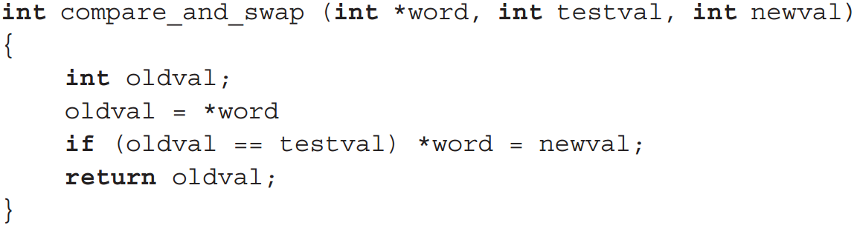
Special Machine Instructions
Compare and Swap Instruction
a compare is made between a memory value and a test value, if the values are the same a swap occurs
carried out atomically

Slide 24
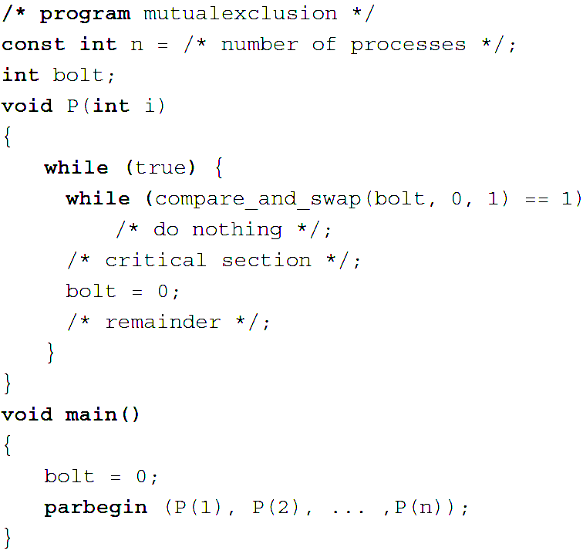
Special Machine Instructions
Concurrent processes

Slide 25
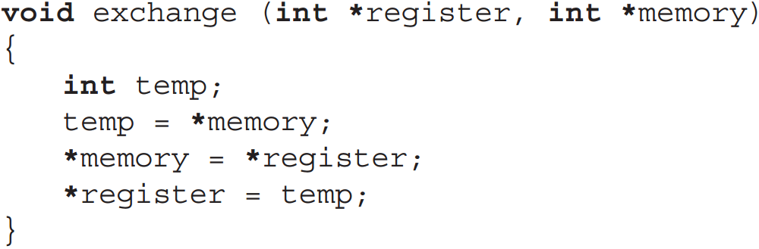
Special Machine Instructions
Exchange Instruction: exchange the contents of a register with the contents of a memory location

Slide 26
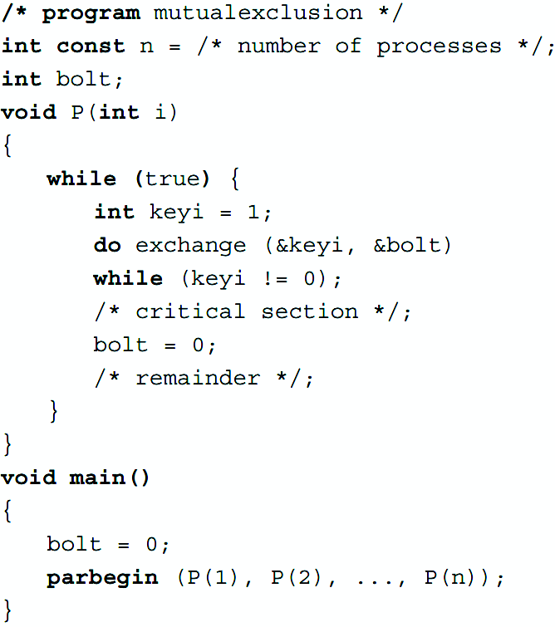
Special Machine Instructions

Slide 27
Machine Instructions
Advantages
Applicable to any number of processes on either a single processor or multiple processors sharing main memory
It is simple and easy to verify
It can be used to support multiple critical sections, each critical section can be defined by its own variable

Slide 28
Machine Instructions
Disadvantages
Busy-waiting consumes processor time (a process does nothing until it is permitted to enter critical section)
Starvation is possible when a process leaves a critical section and more than one process is waiting.

Slide 29
Machine Instructions
Disadvantages
Deadlock is possible
If a low priority process has the critical region and a higher priority process needs, the higher priority process will obtain the processor to wait for the critical region

Slide 30
Semaphores
Processes cooperate by means of signals → a process stop at a place until it receives a specific signal
A special variable called a semaphore is used for signaling
If a process is waiting for a signal, it is suspended until that signal is sent

Slide 31
Semaphores
Semaphore is a variable that has an integer value
May be initialized to a nonnegative number
semWait operation decrements the semaphore value. If the value is negative, the process is blocked.
semSignal operation increments semaphore value. If the value is less than or equal to zero, the process blocked by Wait operation is unblocked.

Slide 32
Semaphores
Semaphore is a variable that has an integer value
If the value is positive, that value equals the number of processes that can issue a wait and immediately continue to execute.
The negative value equals the number of processes waiting to be unblocked.

Slide 33
Semaphores
Consequences
There is no way to know before a process decrements a semaphore whether it will block or not
After a process increments a semaphore and another process is unblocked, two processes are running concurrently, there is no way to know which process will continue immediately on a uniprocessor system
You don’t know whether another process is waiting to be unblocked

Slide 34
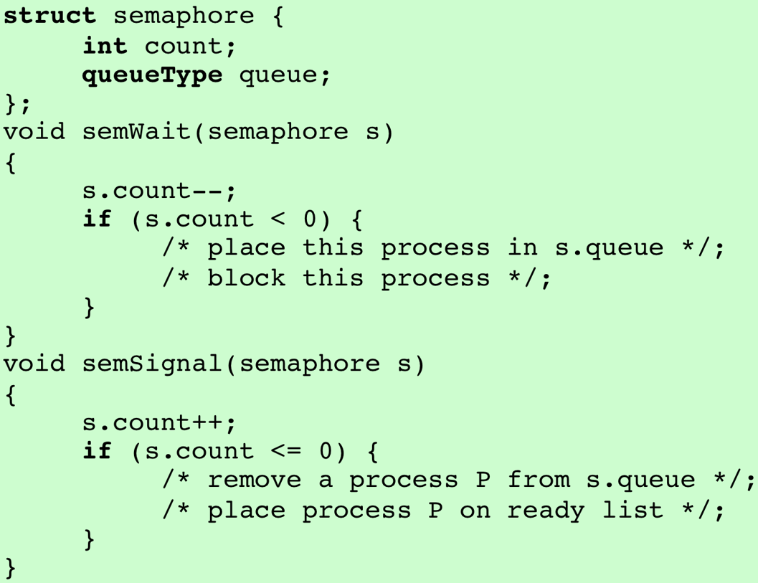
Definition of Semaphore Primitives

Slide 35
Binary Semaphore
May be initialized to 0 or 1
semWaitB operation checks the semaphore value.
If the value is zero, then the process executing the semWaitB is blocked.
If the value is one, the value is changed to zero and the process continues execution.

Slide 36
Binary Semaphore
semSignalB operation checks to see if any processes are blocked on this semaphore (semaphore value equals 0)
If so, then a process blocked by a semWaitB operation is unblocked.
If no processes are blocked, then the value of the semaphore is set to one.

Slide 37
Binary Semaphore Primitives

Slide 38
Binary Semaphore
A concept related to the binary semaphore is the mutual exclusion lock (mutex)
Key difference between the a mutex and a binary semaphore is that the process that locks the mutex must be the one to unlock it

Slide 39
Semaphore
A queue is used to hold processes waiting on the semaphore
If FIFO policy is used to remove processes from the queue – strong semaphore (guarantee freedom from starvation)
If no policy is specified – weak semaphore

Slide 40
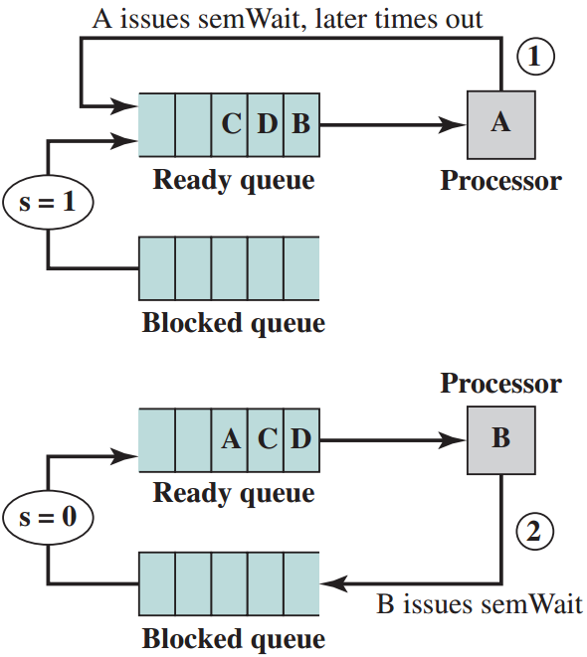
Semaphore
Processes A, B, and C depend on a result from process D

Slide 41
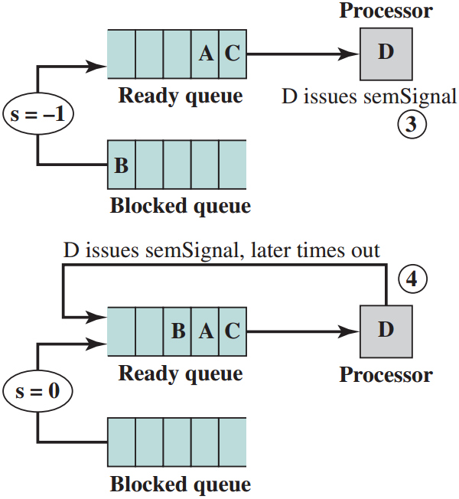
Semaphore

Slide 42
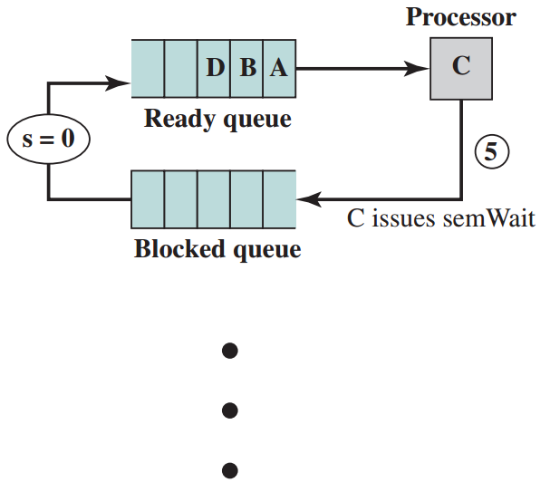
Semaphore

Slide 43
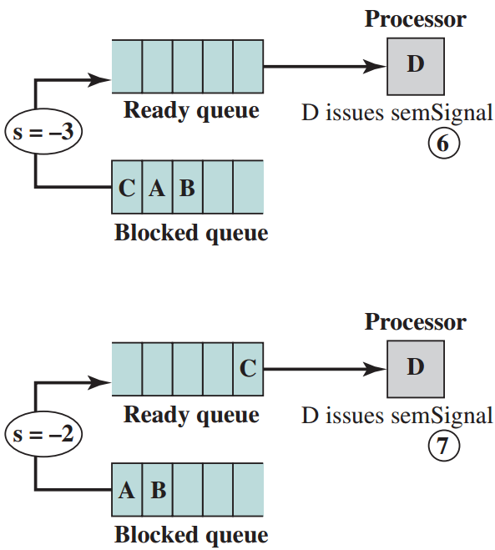
Semaphore

Slide 44
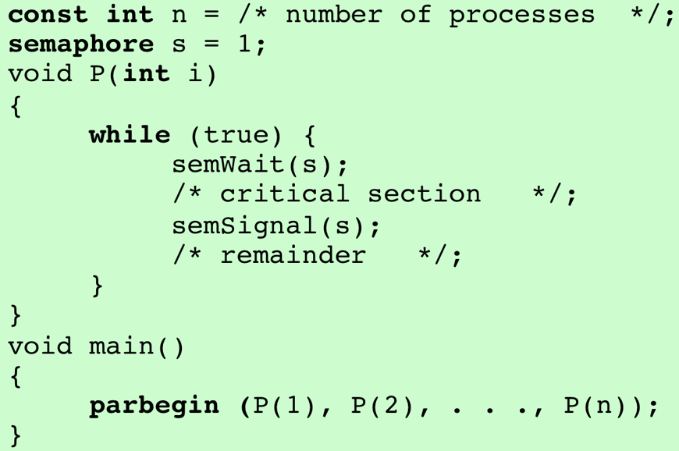
Mutual Exclusion Using Semaphores

Slide 45
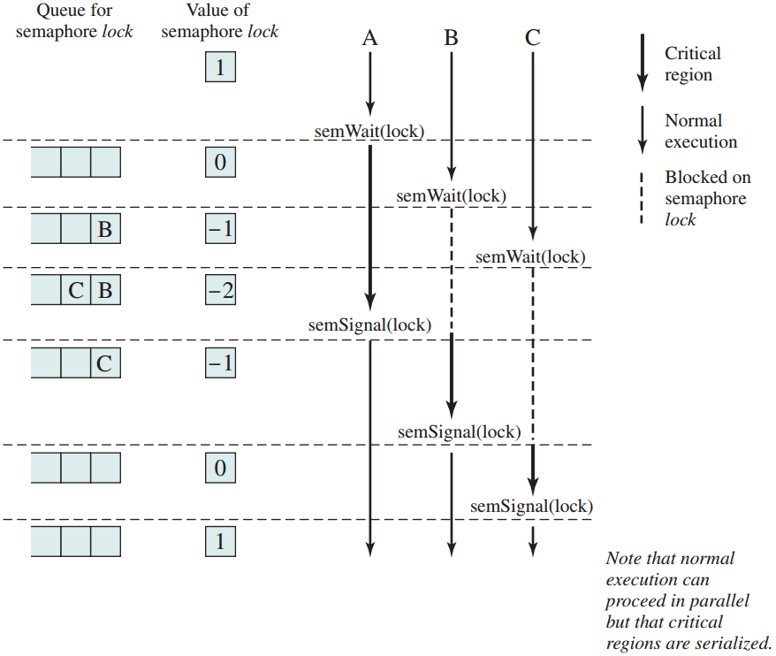
Mutual Exclusion Using Semaphores

Slide 46
Producer/Consumer Problem
One or more producers are generating data and placing these in a buffer
A single consumer is taking items out of the buffer one at time
Only one producer or consumer may access the buffer at any one time

Slide 47
Producer/Consumer Problem
The problem:
To ensure that the producer can’t add data into full buffer and
the consumer can’t remove data from an empty buffer

Slide 48
Producer Function
producer:
while (true) {
/* produce item v */;
b[in] = v;
in++;
}

Slide 49
Consumer Function
consumer:
while (true) {
while (in <= out)
/*do nothing */;
w = b[out];
out++;
/* consume item w */;
}

Slide 50
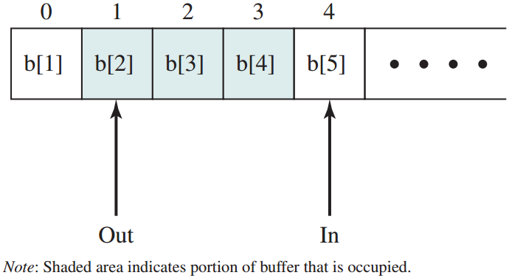
Producer/Consumer Problem
Infinite buffer

Slide 51
Incorrect Solution with Binary Semaphore

Slide 52
Incorrect Solution with Binary Semaphore

Slide 53
Incorrect Solution with Binary Semaphore
semWaitB() in Line 14 failed

Slide 54
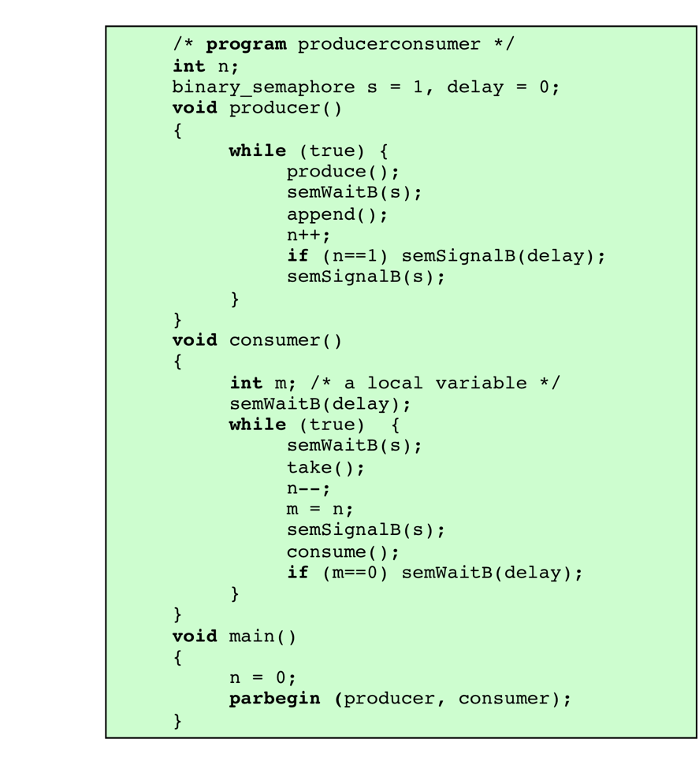
Correct Solution with Binary Semaphore

Slide 55

Solution with Semaphore

Slide 56
Producer with Circular Buffer
Producer:
while (true) {
/* produce item v */;
while ((in + 1) % n == out)
/* do nothing */;
b[in] = v;
in = (in + 1) % n;
}

Slide 57
Consumer with Circular Buffer
Consumer:
while (true) {
while (in == out)
/* do nothing */;
w = b[out];
out = (out + 1) % n;
/* consume item w */;
}

Slide 58
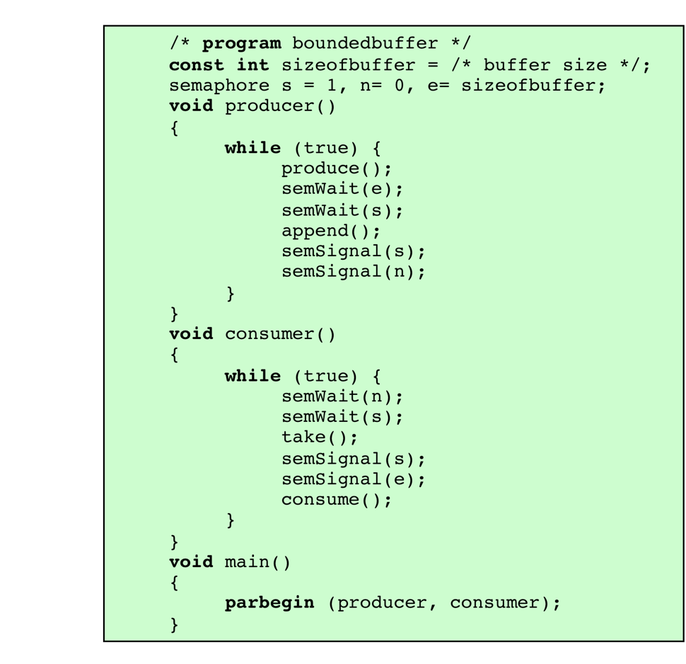
Solution with Semaphore - Bounded-Buffer

Slide 59
Monitors
Programming language constructs that provide equivalent functionality to that of semaphores but easier to control
Implemented in a number of programming languages: Concurrent Pascal, Pascal-Plus, Modula-2, Modula-3, and Java
Also been implemented as a program library

Slide 60
Monitors
Consisting of one or more procedures, an initialization sequence, and local data
Chief characteristics
Local data variables are accessible only by the monitor
Process enters monitor by invoking one of its procedures
Only one process may be executing in the monitor at a time, others will be blocked

Slide 61
Monitors – Synchronisation
A process invokes the monitor and blocked until some condition is satisfied
Facility is needed by which the process is blocked and releases the monitor to be used by other process
When the condition is satisfied and the monitor is available, the process will be resumed and re-enter the monitor at the suspension point

Slide 62
Monitors – Synchronisation
Achieved by the use of condition variables contained within the monitor and accessible only within the monitor
Condition variables are operated on by 2 functions:
cwait(c): suspend execution of the calling process on condition c
csignal(c): resume execution of some process blocked after a cwait on the same condition. If there is no such process, do nothing.

Slide 63
Monitors – Synchronisation
A process may temporarily block itself on condition x by issuing cwait (x)
If a process that is executing in the monitor detects a change in the condition variable x, it issues csignal (x)

Slide 64
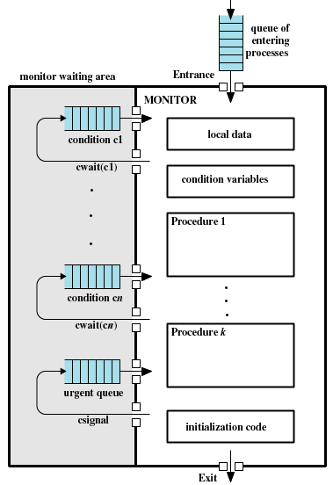
Monitors

Slide 65
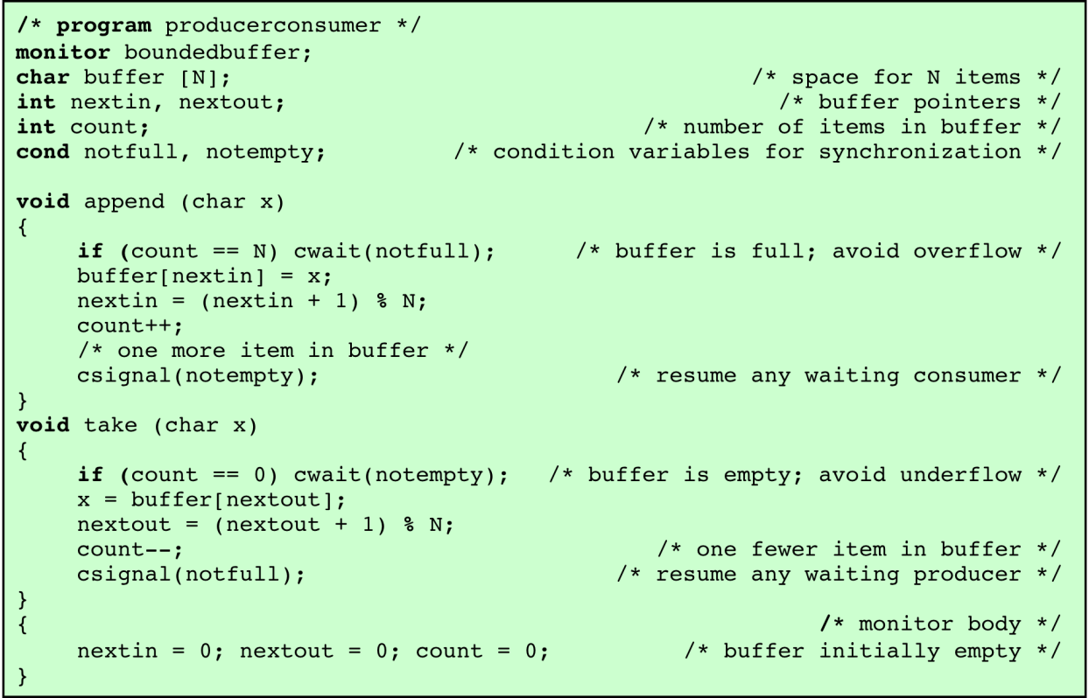
Monitors – Producer/Consumer Problem

Slide 66
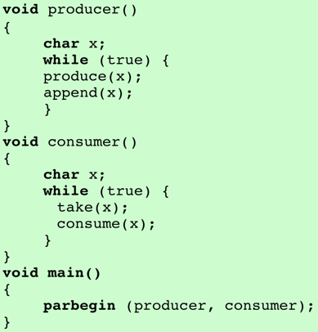
Monitors – Producer/Consumer Problem

Slide 67
Monitors – Producer/Consumer Problem
Advantage over semaphores: all synchronisation functions are confined to the monitor
easier to verify that the synchronization has been done correctly and detect bugs
Once a monitor is correctly programmed, access to the protected resource is correct for access from all processes

Slide 68
Message Passing
When processes interact with one another, 2 requirements must be satisfied:
Synchronization → to enforce mutual exclusion
Communication → exchange information
Message Passing is one approach to provide both of these functions
Advantage: works with distributed systems and shared memory multiprocessor and uniprocessor systems

Slide 69
Message Passing
A pair of primitives:
send (destination, message)
receive (source, message)

Slide 70
Message Passing
Sender and receiver may or may not be blocking (waiting for message)
Blocking send, blocking receive:
Both sender and receiver are blocked until message is delivered
Allows for tight synchronisation between processes

Slide 71
Synchronization
Nonblocking send, blocking receive
Sender continues on but receiver is blocked until the requested message arrives
Allow a process to send message(s) to a variety of destinations as quick as possible
Nonblocking send, nonblocking receive:
Neither party is required to wait

Slide 72
Addressing
Two categories:
Direct addressing
Indirect addressing

Slide 73
Addressing
Two categories:
Direct addressing
Indirect addressing
Direct addressing
Send primitive includes a specific identifier of the destination process
Receive primitive could know ahead of time which process a message is expected → explicitly designate a source
Receive primitive could use source parameter to return a value when the receive operation has been performed

Slide 74
Addressing
Direct addressing
Send primitive includes a specific identifier of the destination process
Receive primitive can be handled in one of two ways:
require the process explicitly designate a sending process
implicit addressing
source parameter to return a value when the receive operation has been performed

Slide 75
Addressing
Indirect addressing
Messages are sent to a shared data structure consisting of queues (not to the receiver)
Queues are referred to as mailboxes
One process sends a message to the mailbox and the other process picks up the message from the mailbox
Allows greater flexibility in the use of messages

Slide 76
Message Format
Consists of header and body of message

Slide 77
Mutual Exclusion Using Messages
If a process wants to enter its critical section, it first attempts to receive a message. If the mailbox empty, the process is blocked until it acquires a message.
The message is placed back into mailbox after the critical section.

Slide 78
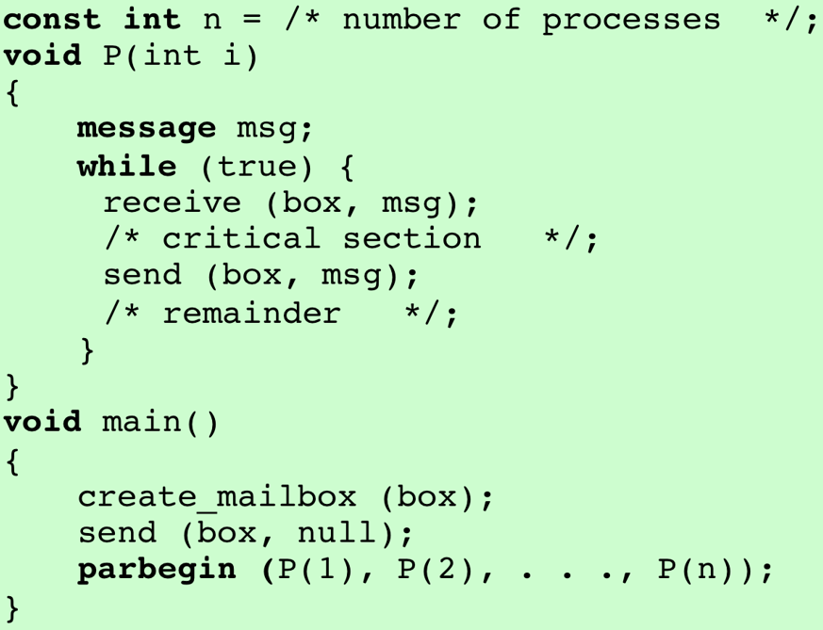
Mutual Exclusion Using Messages

Slide 79
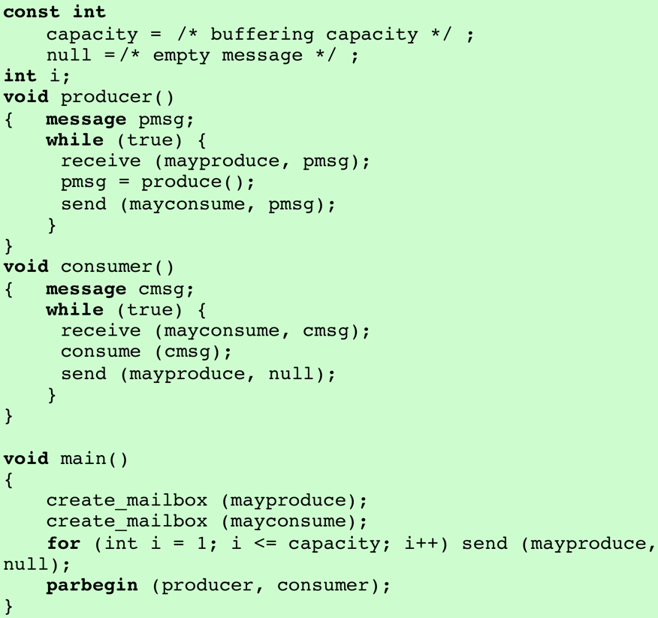
Mutual Exclusion Using Messages

Slide 80
Readers/Writers Problem
A data area is shared among many processes
Reader processes only read the data area
Writer processes only write to the data area
Conditions that must be satisfied:
any number of readers may simultaneously read the file
only one writer at a time may write to the file
if a writer is writing to the file, no reader may read it

Slide 81
Readers/Writers Problem – Message Passing

Slide 82
Readers/Writers Problem – Message Passing
The action of the controller:
If count > 0, no writer is waiting and may / may not be readers active. Service all “finished” messages first to clear active readers. Then service write requests and then read requests.
If count = 0, only write request outstanding. Allow the writer to proceed and wait for a “finished” message.
If count < 0, a writer has made a request. Only service “finished” messages, to clear all active readers.

